Slide 1
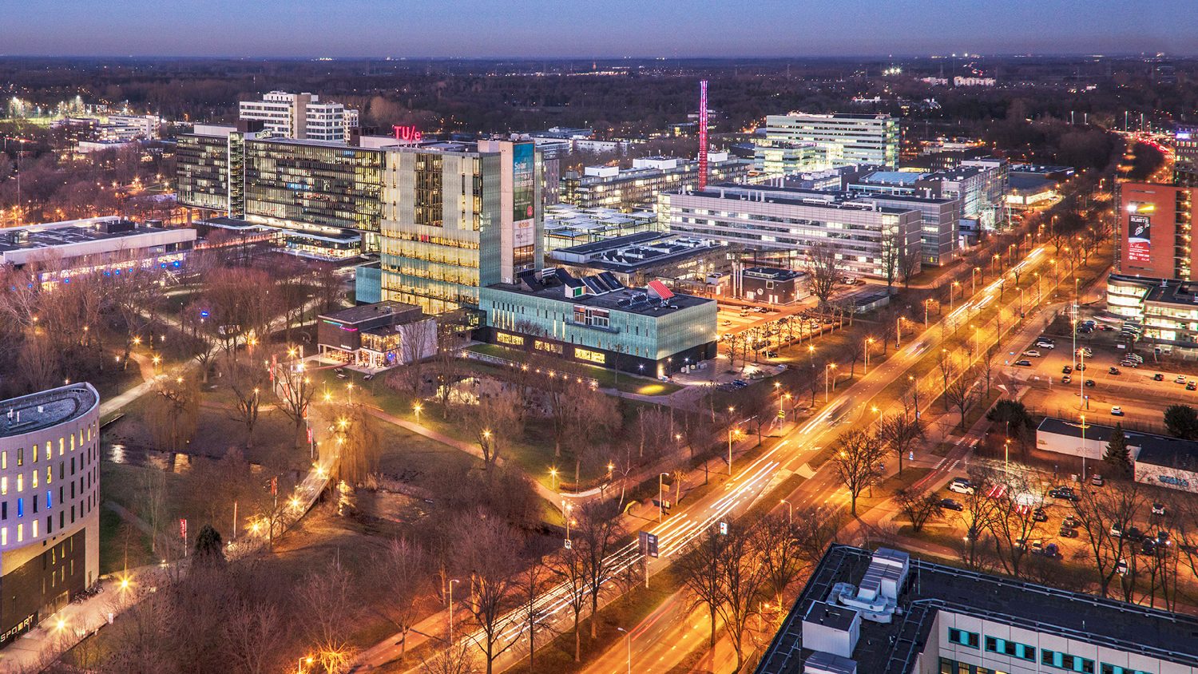
Progress Meeting Diploma Thesis Project Bubble Tracking
16.03.2021
Josefine Gatter
Chemical Engineering and Chemistry, Chemical Process Intensification

Slide 2
Kalman Filter based Centroid Tracker
Assigns detected bounding boxes (img n+1) to tracked bounding boxes (img n) using IoU as a distance metric
Get centroids from bboxes of img n (track img) and img n+1 (detection img)
distance.cdist Distance between each pair of two centroid collections
Linear_sum_assignment Linear sum assignment problem Minimum weight matching
Filter out matches with high distance between centroids centroid_dist > distance_threshold
Tracker — Multi-object trackers in Python 1.0.0 documentation (adipandas.github.io)
motrackers.centroid_kf_tracker — Multi-object trackers in Python 1.0.0 documentation (adipandas.github.io)
scipy.spatial.distance.cdist — SciPy v1.8.0 Manual
scipy.optimize.linear_sum_assignment — SciPy v0.18.1 Reference Guide

Slide 3
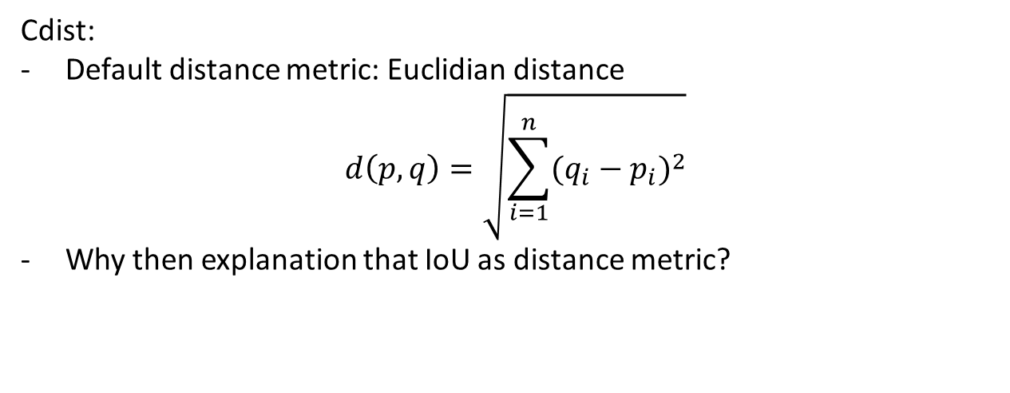
Cdist:
Default distance metric: Euclidian distance
$$d\left(p,q\right)=\sqrt{\sum_{i=1}^{n}{{(q_{i}−p_{i})}^{2}}}$$
Why then explanation that IoU as distance metric?

Slide 4
Example 1
243 matched boxes for t02_0001_t05_0001
270 matched boxes for t05_0001_t10_0001
264 matched boxes for t10_0001_t15_0001
225 matched boxes for t15_0001_t20_0001
196 matched boxes for t20_0001_t25_0001
170 matched boxes for t25_0001_t30_0001
159 matched boxes for t30_0001_t35_0001
148 matched boxes for t35_0001_t40_0001
Centernet 7
Supersaturation 0.16
Detection_threshold 0.5
tracker_threshold = 50
19 unmatched boxes for t02_0001
51 unmatched boxes for t05_0001
33 unmatched boxes for t10_0001
54 unmatched boxes for t15_0001
37 unmatched boxes for t20_0001
31 unmatched boxes for t25_0001
25 unmatched boxes for t30_0001
17 unmatched boxes for t35_0001

Slide 5
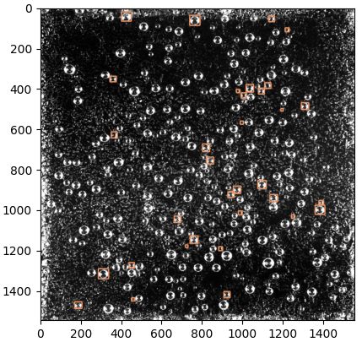
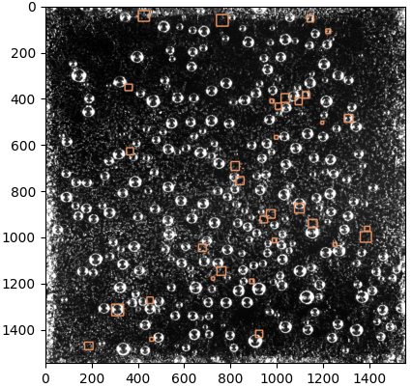
t10__0001_Unmatched & t15_0001_LostBoxes

Slide 6
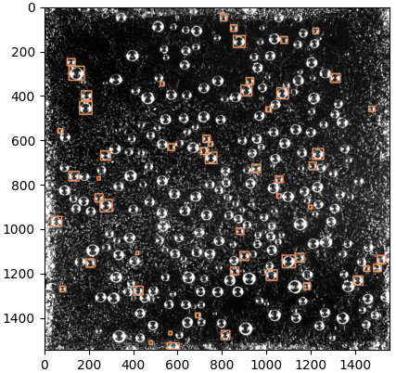
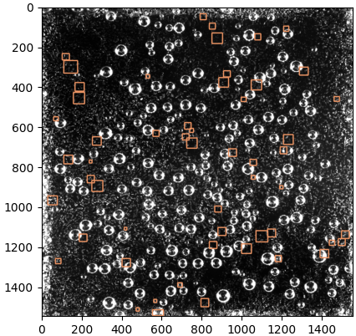
t15_0001_Unmatched & t20_0001_LostBoxes

Slide 7
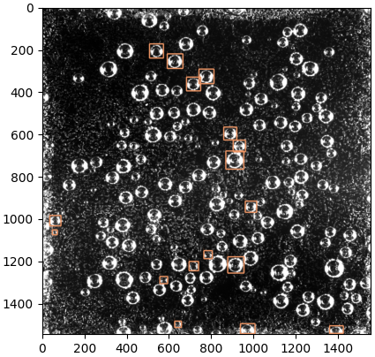
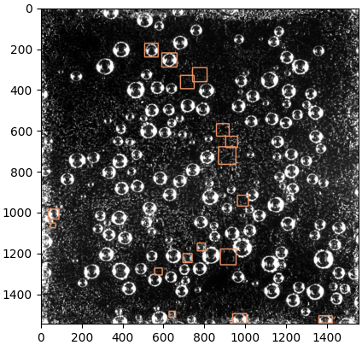
t35_0001_Unmatched & t40_0001_LostBoxes

Slide 9
